Slide 1
3D printing
David Hoepelman
02-08-2022

Slide 2
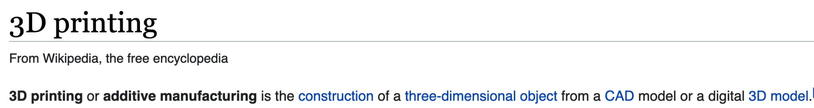

Slide 3
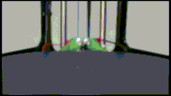

Slide 4
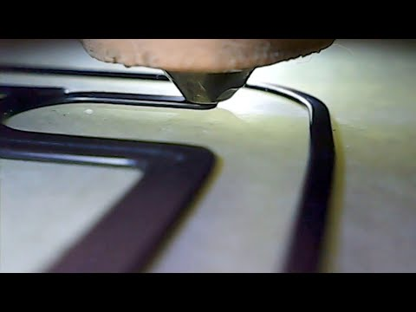

Slide 6
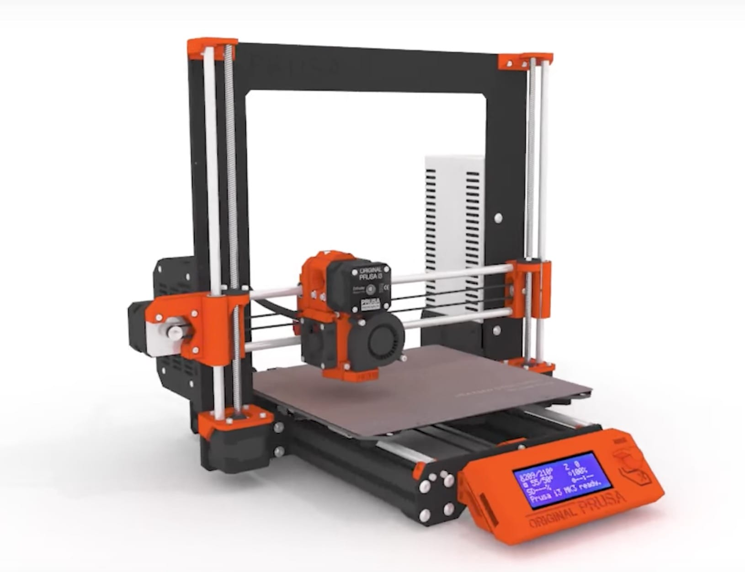
What you need: 3D printer
Consumer models €200 - €3.000

Slide 7
What you need: 3D printer
Xebia has a Prusa i3 MK2S and MK3 which you can use.
Good and easy to use, MK3+ costs about €1200

Slide 8
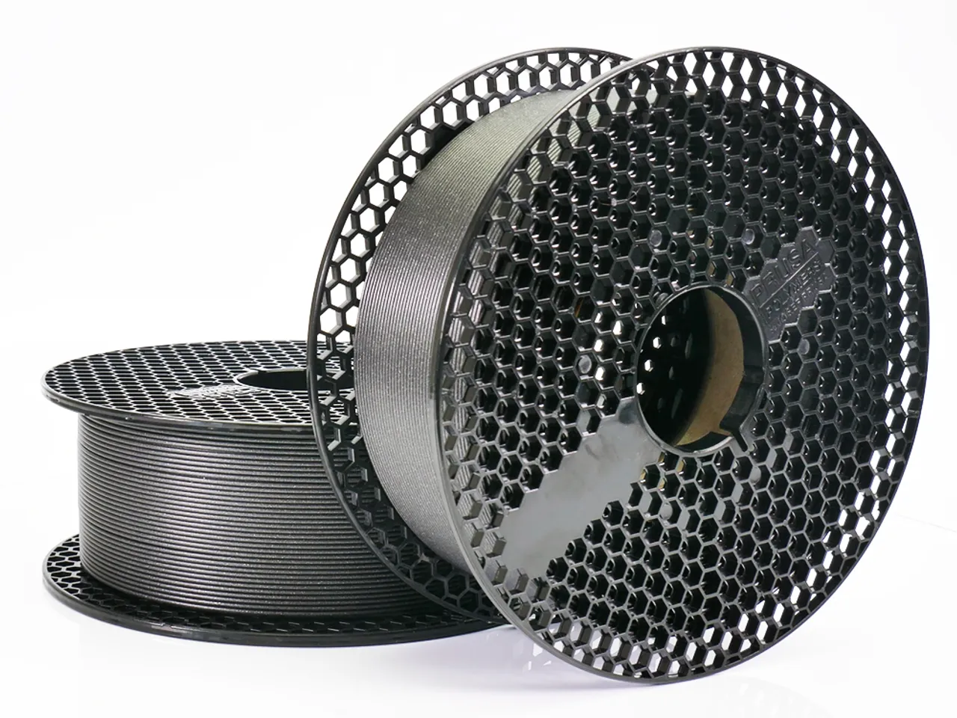
What you need: Filament
About €20-€35/kg
Plastic type usually “PLA”

Slide 9
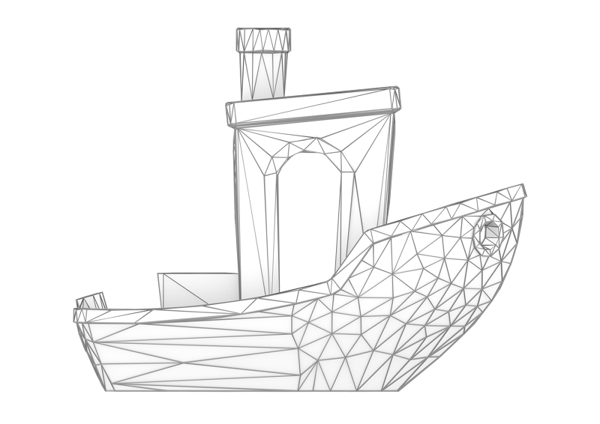
What you need: 3D model
Lots of free downloads on printables.com, thingiverse.com
Can design your own with CAD or 3D-modeling software

Slide 10
Slicer
3D models are usually shared or exported as .stl files
Slicers turn .stl files into “G-Code”, instructions for your specific 3D printer

Slide 11
Slicer
Lot’s of slicers
PrusaSlicer - Also for non-Prusa printers
Cura
Simplify3D - Paid
Creality Slicer - Creality printers only

Slide 12
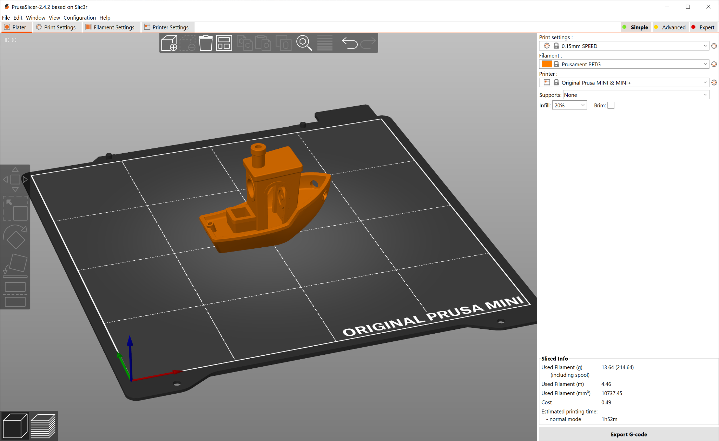
Slicer

Slide 13
Important tuning knobs
Layer height: detail v.s. printing time trade-off
Detailed prints: 0.07 or 0.1mm Large or simple shapes: 0.2mm or 0.25mm

Slide 14
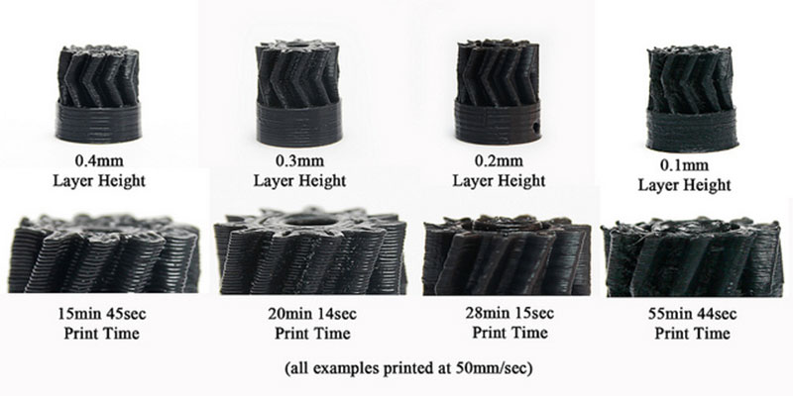

Slide 15
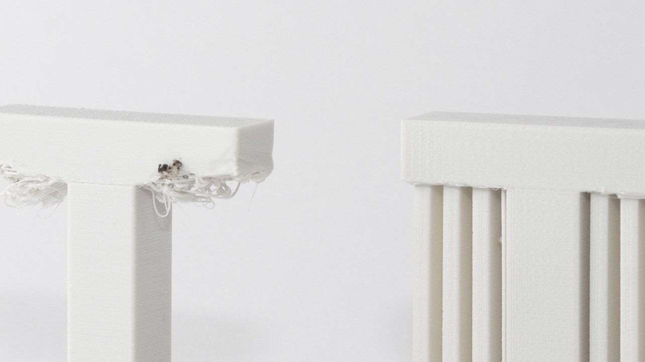
Supports

Slide 16
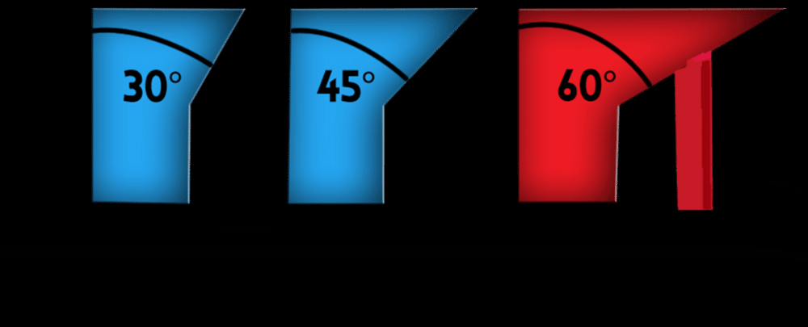
Supports

Slide 17
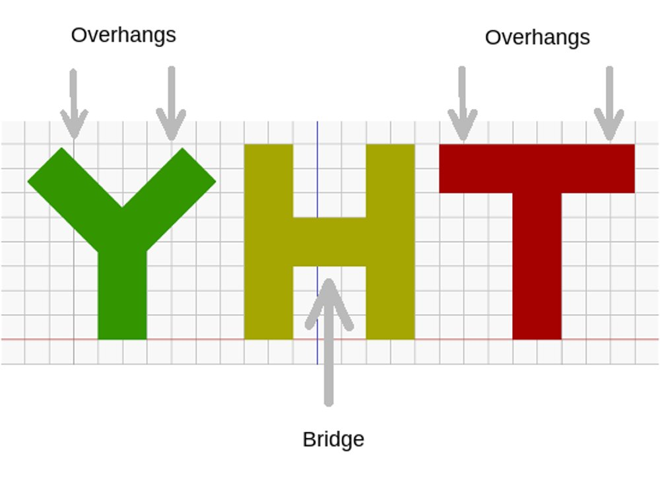

Slide 18
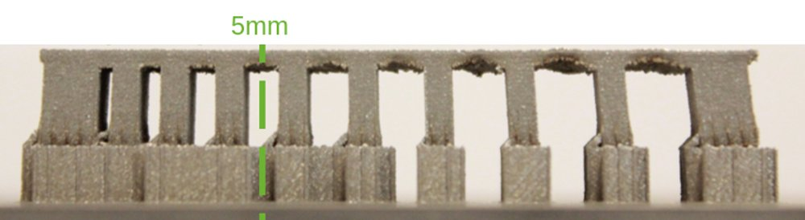
Supports: bridges

Slide 19
Bed adhesion
Most common reason why prints fail: print gets loose from the bed

Slide 20
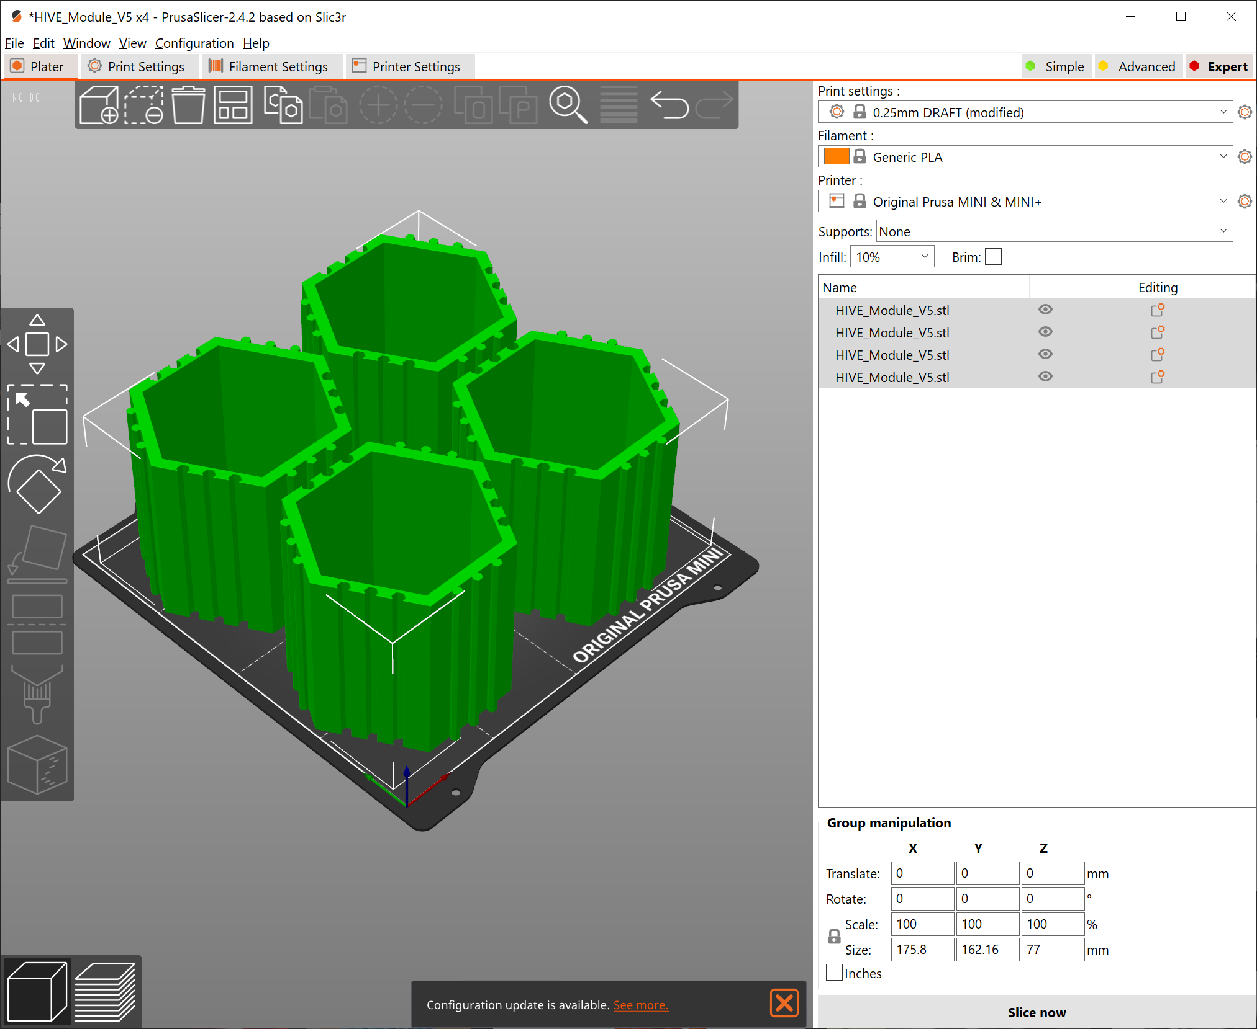
Bed adhesion
Expectation:

Slide 21
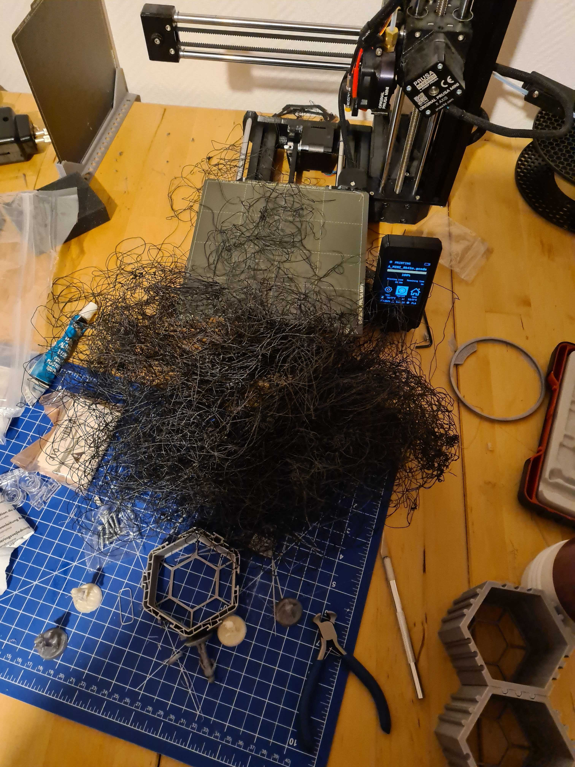
Bed adhesion: spaghetti

Slide 22
Bed adhesion
Fat and fingerprints are your enemy
Always clean your build plate with alcohol and a clean microfiber cloth before printing
Use dishwashing soap once in a while too
No air drafts
15° C or higher, and/or increase bed heat
“Brims” and “Rafts” can increase print surface area
Nuclear option: use hairspray or glue stick

